Slide 1
Color Categories in Macaque Monkeys
Daniel Garside
UNR
16th March 2023
Notes:
Source: https://irp.nih.gov/brand-materials/irp-powerpoint-templates
Event: https://www.colour.org.uk/january-vision-meeting-2022/

Slide 2
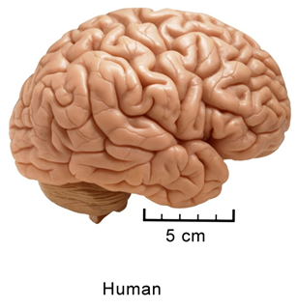
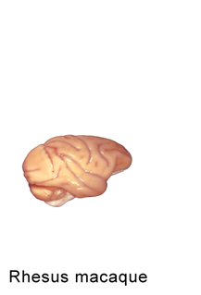
Human vs macaque
Electrode recording
Electrode recording
Psychophysics
Psychophysics

Slide 3
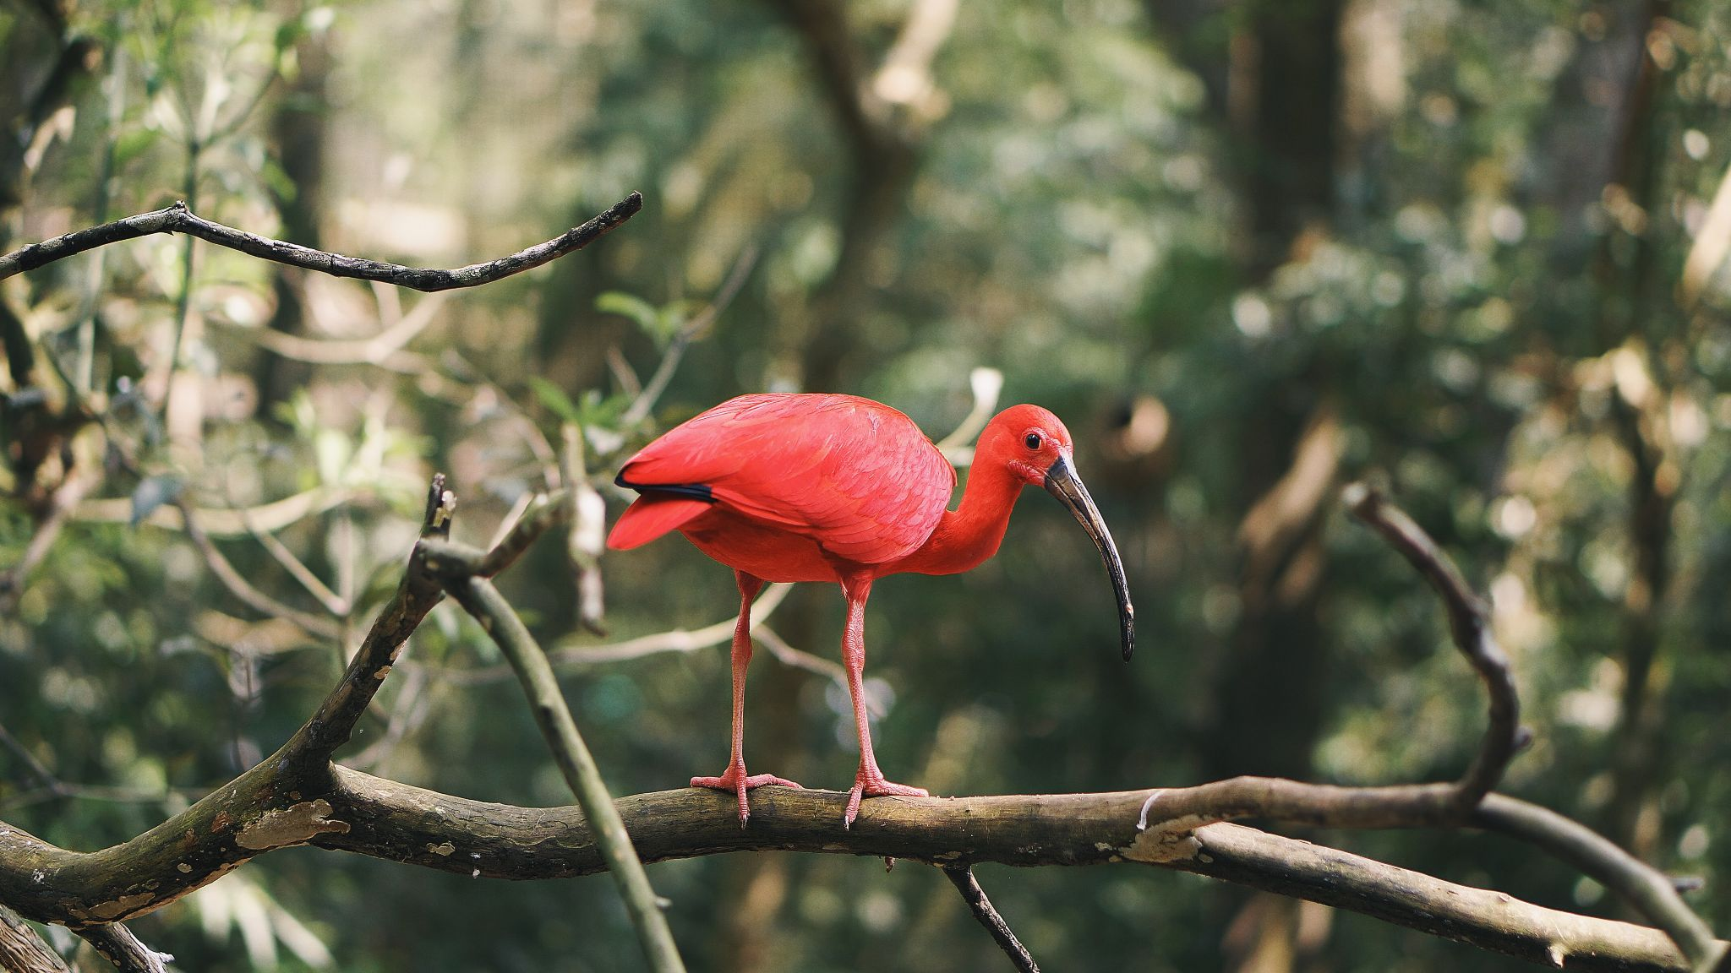
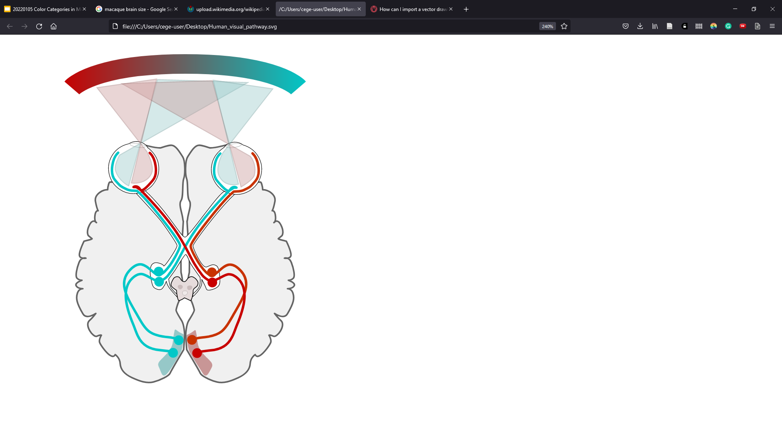
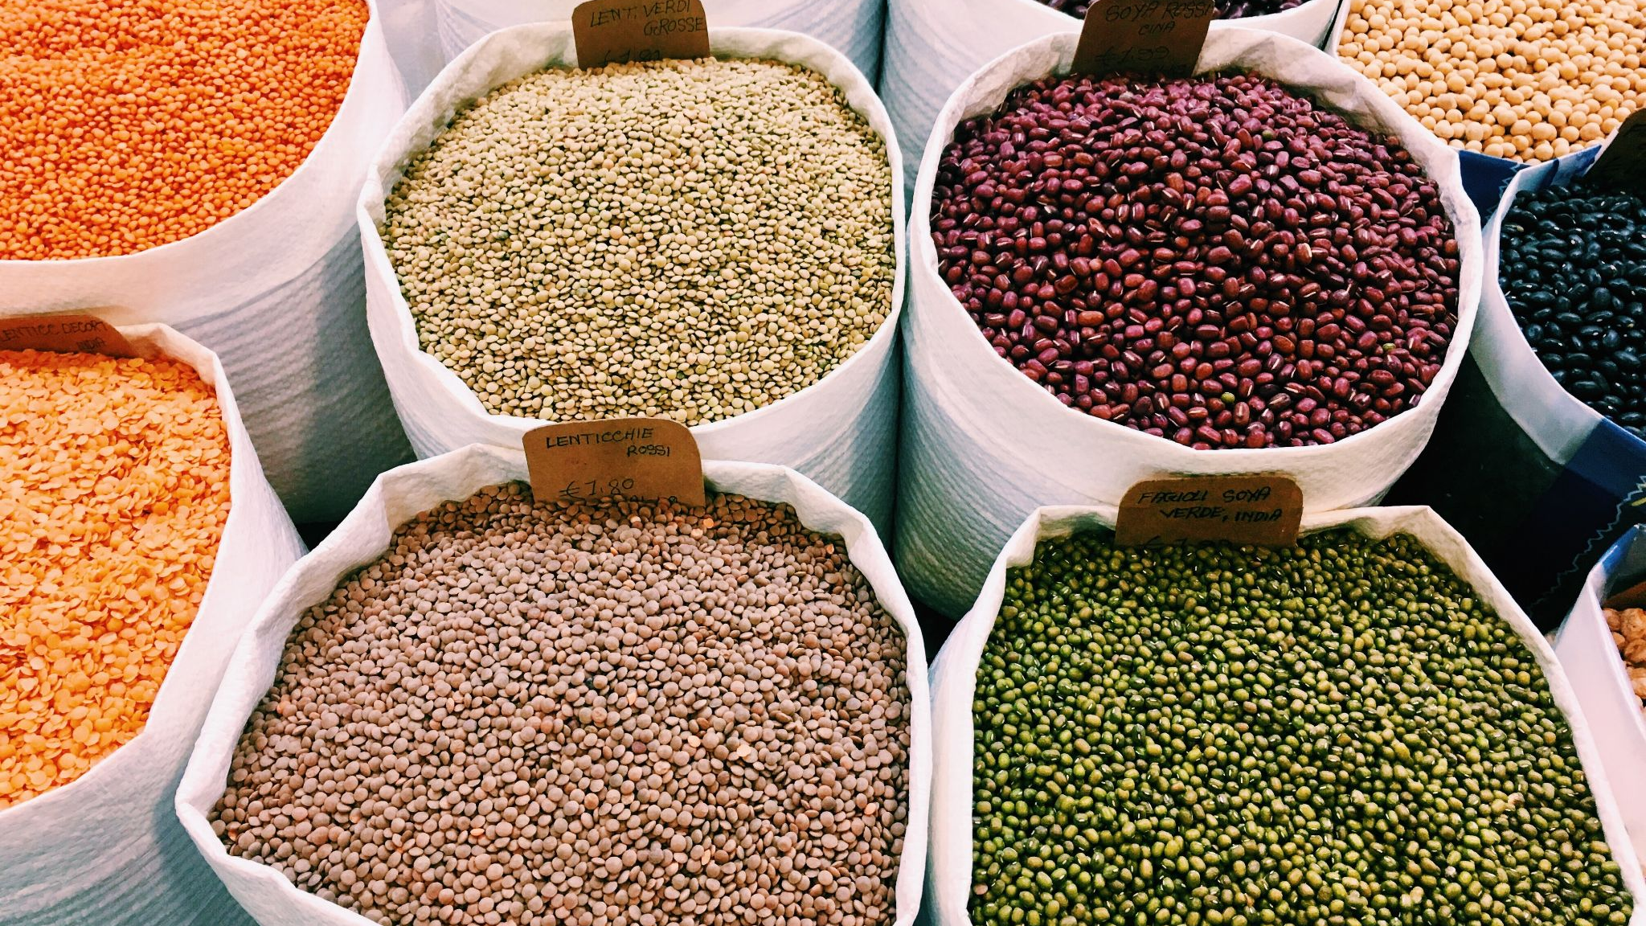
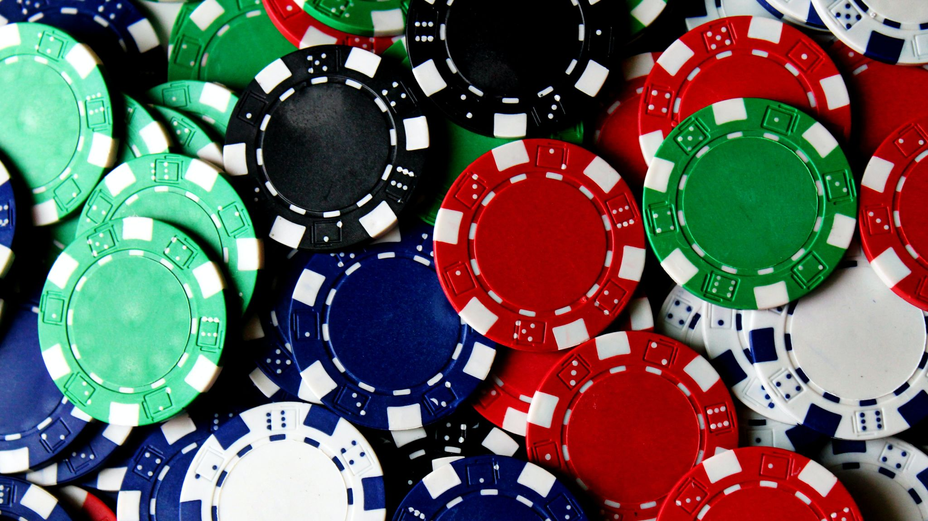
Different levels of color
Receptoral
Post-receptoral
V1
Extra-striate
Notes:
Image: Miquel Perello Nieto

Slide 4
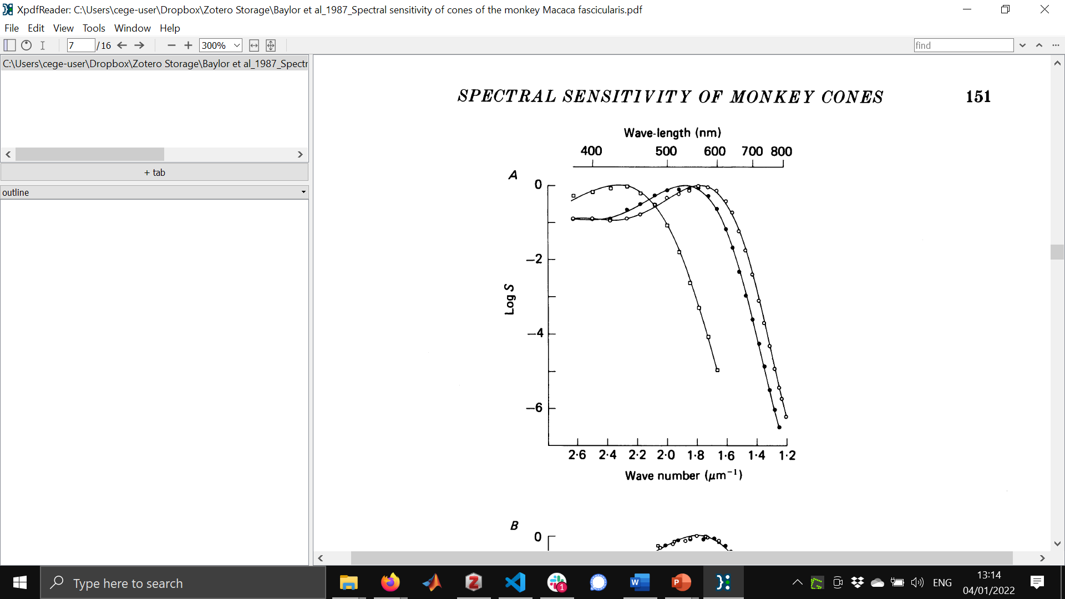
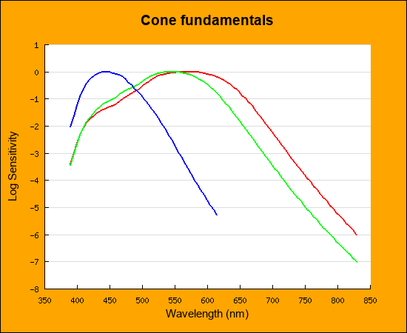
Receptoral
Macaque
Human
Baylor (1987)
Stockman & Sharpe (2000)
Notes:
Image: Miquel Perello Nieto

Slide 5
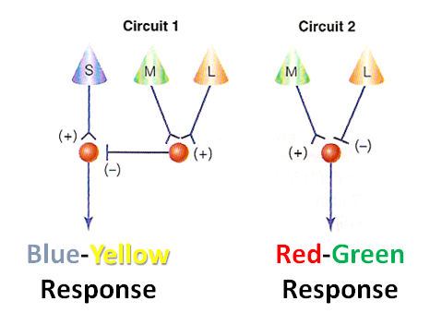
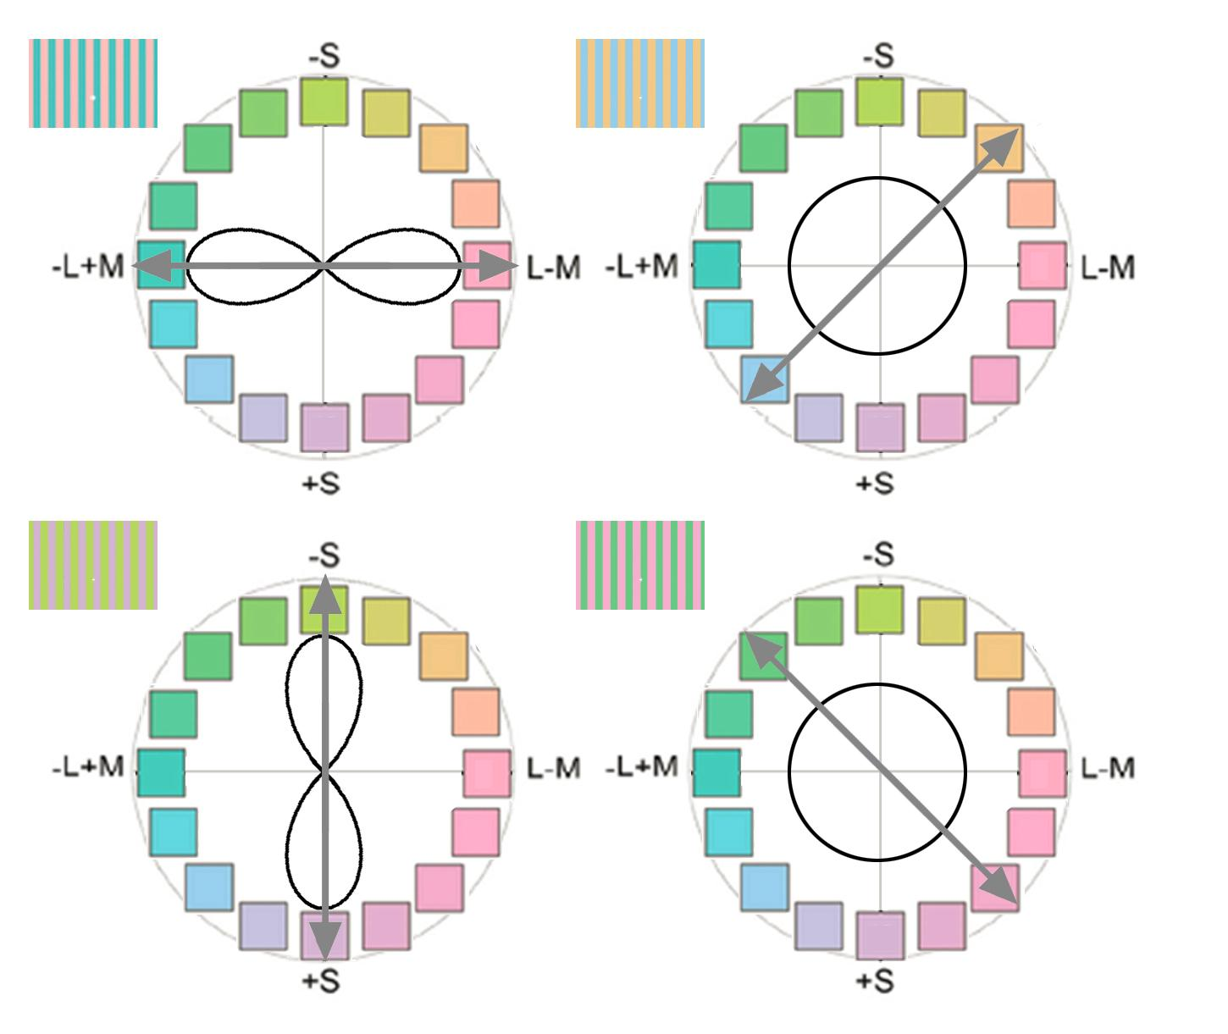
Post-receptoral
Prediction
If there is a neural mechanism selective for the adaptation colors
→ increased detection thresholds for those colors
S - (L + M)
- L + M

Slide 6
Standard Model, predicted changes in detection threshold

Slide 7
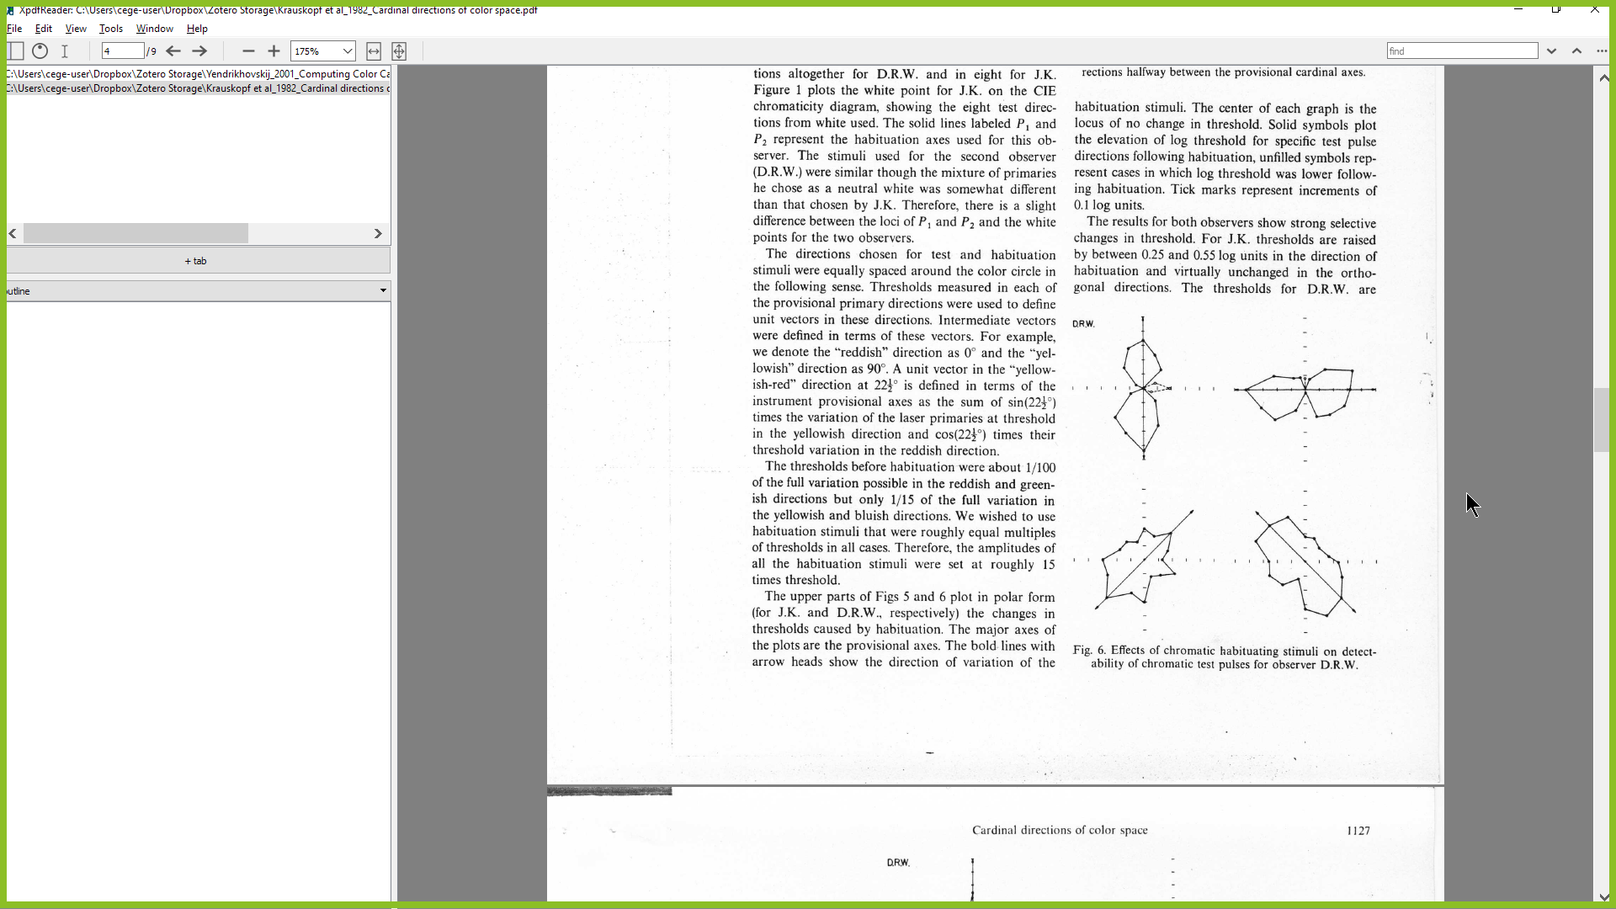
Standard Model, predicted changes in detection threshold
Human data - Krauskopf (1982)

Slide 8
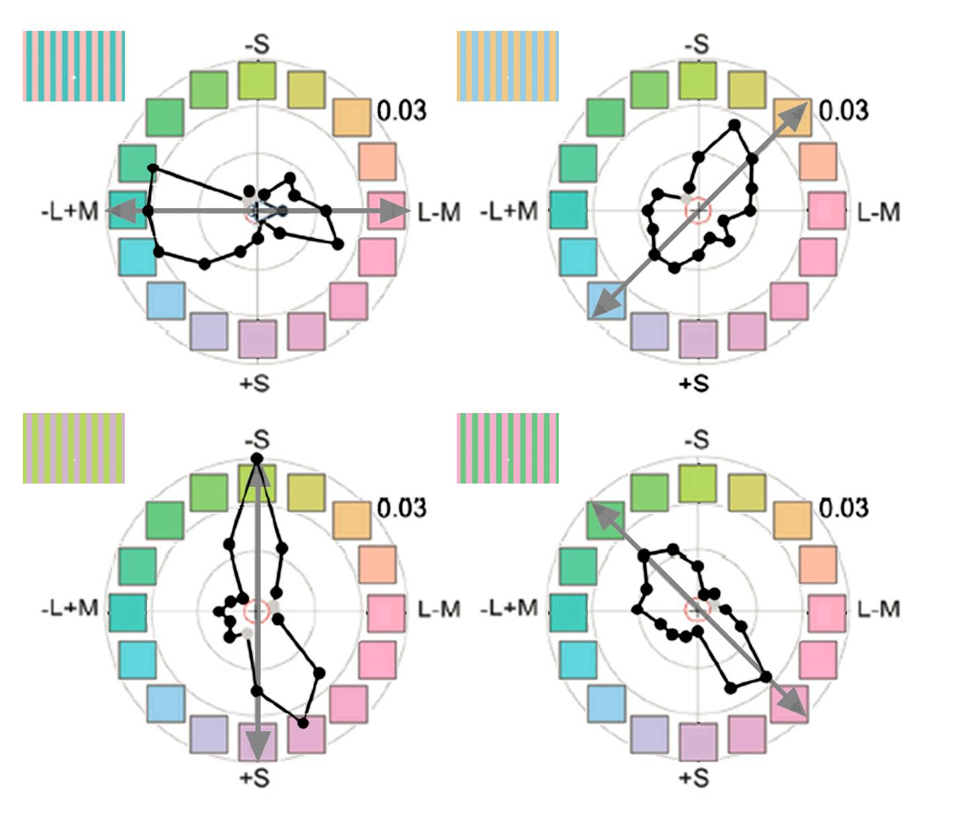
Standard Model, predicted changes in detection threshold
Human data - Krauskopf (1982)
Stoughton et al. (2012) J Neurosci
Gagin et al. (2014) J. Vision

Slide 9
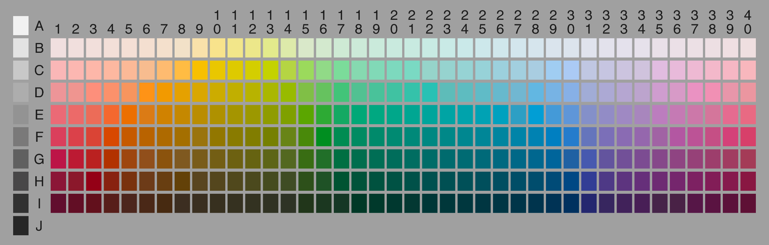
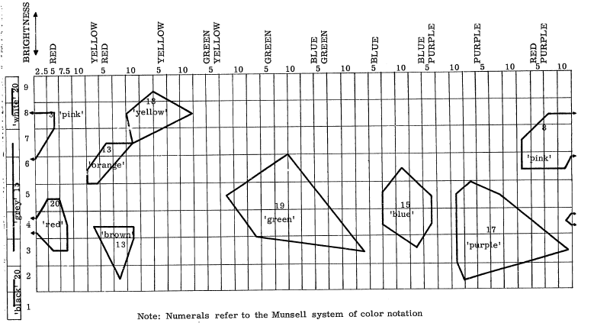
Verbal tests
Berlin and Kay (1969)
Notes:
https://www1.icsi.berkeley.edu/wcs/data.html

Slide 10
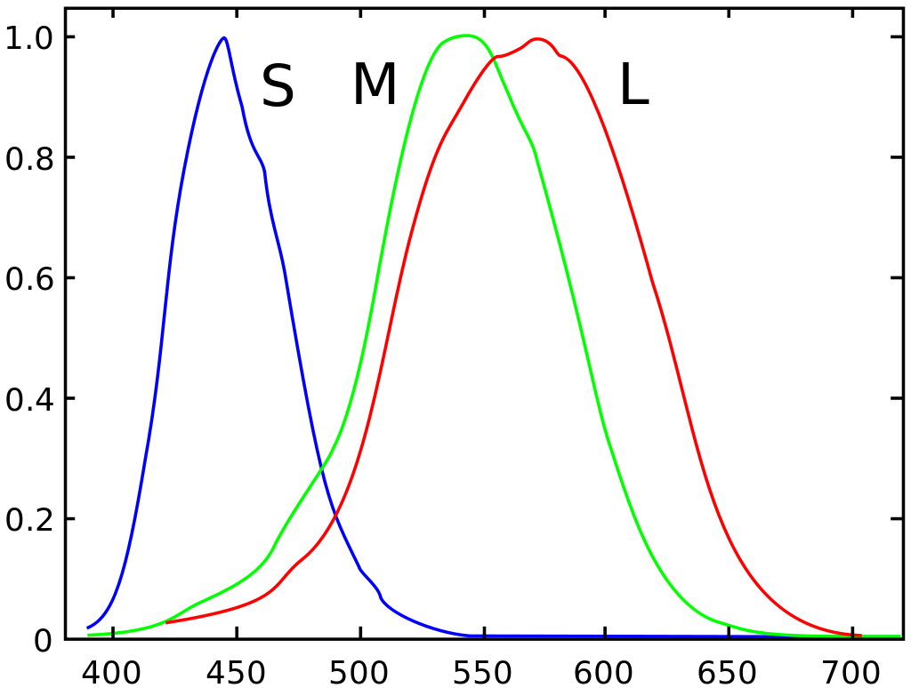
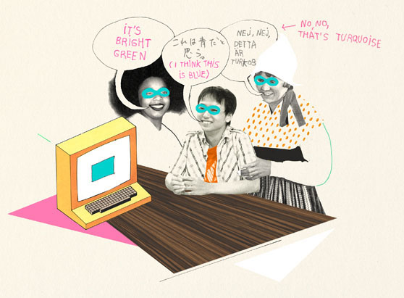
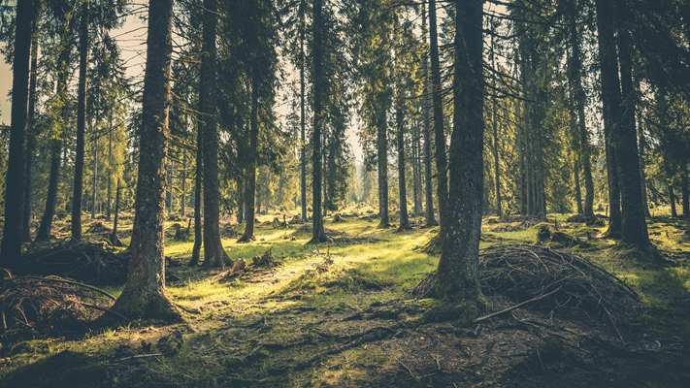
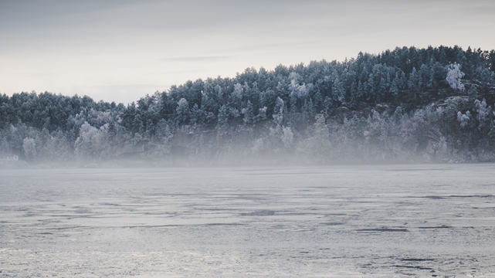
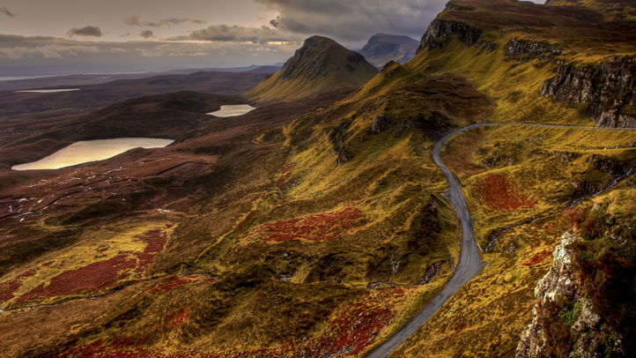
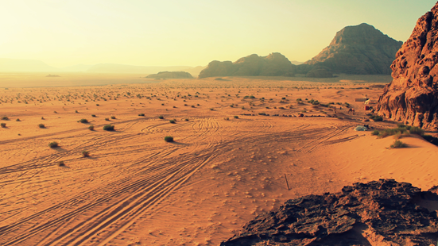
Theories of Color Categorization
Learned factors
Innate factors
Cone spectral absorption functions
Verbal communication of color
Valero Doval for colornaming.net
Color statistics of natural scenes

Slide 11
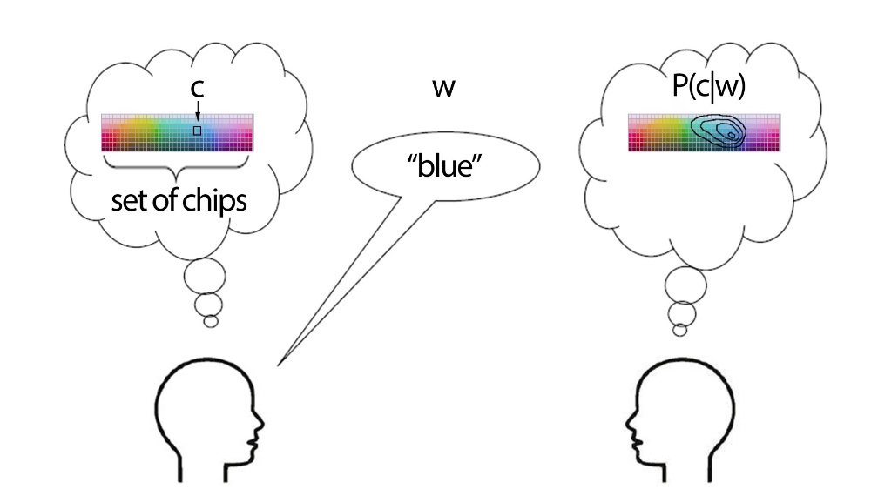
I pick a specific color chip and use a word to describe it
Gibson et al, PNAS 2017

Slide 12
I pick a specific color chip and use a word to describe it
How many guesses do you need to figure out the color?
Gibson et al, PNAS 2017

Slide 13
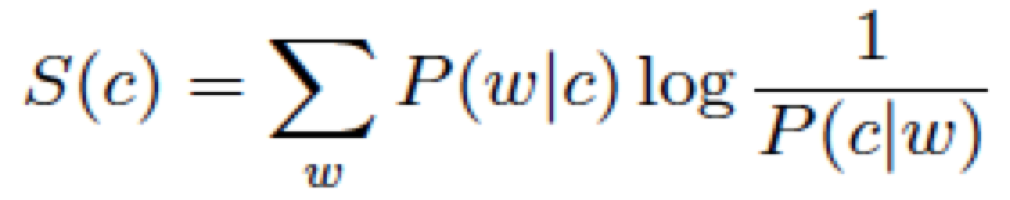
I pick a specific color chip and use a word to describe it
How many guesses do you need to figure out the color?
Gibson et al, PNAS 2017

Slide 14
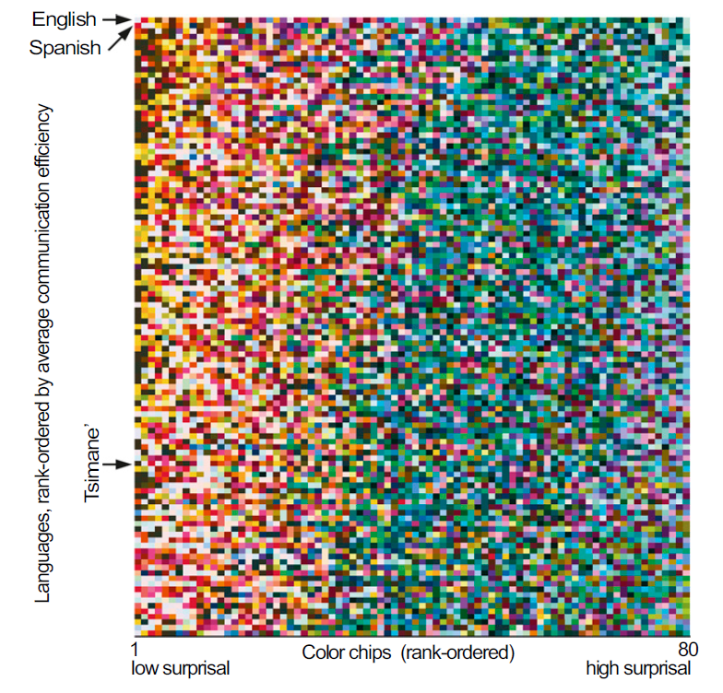
All languages show higher communicative efficiency for warm over cool colors
I pick a specific color chip and use a word to describe it
How many guesses do you need to figure out the color?
Gibson et al, PNAS 2017

Slide 15
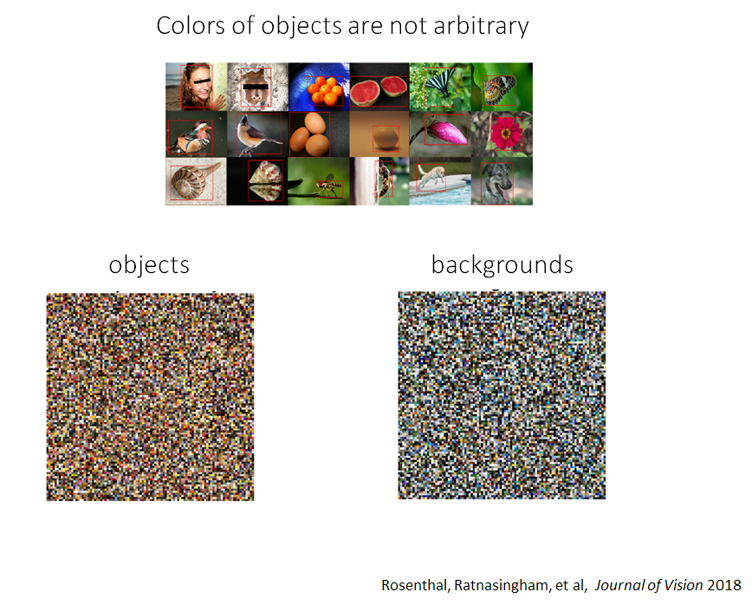

Slide 16
Signatures of categorical behavior
Smaller
discrimination thresholds across category borders
Bias towards
best exemplar of category (“focal color”)
*
*
Category 1
Category 2
Category 1
Category 2

Slide 17
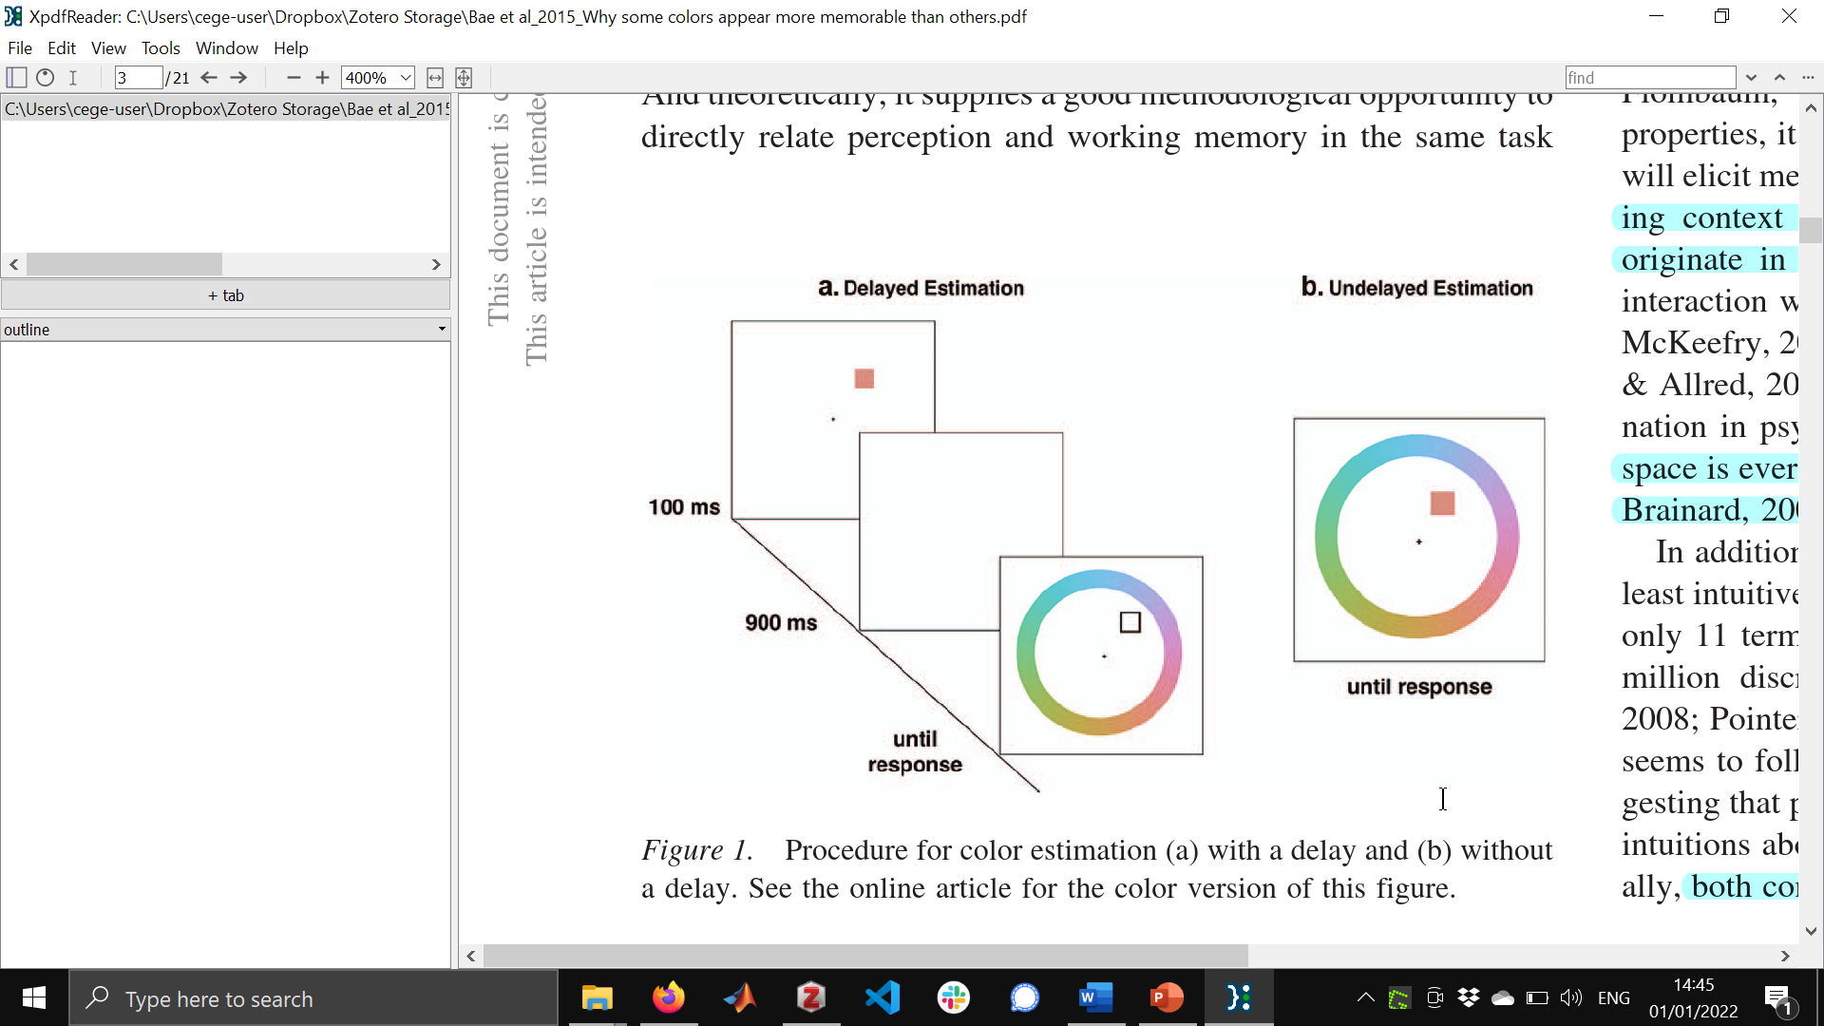
Bae et al. (2015) JEP:G

Slide 18
Cue

Slide 19

Choice

Slide 20
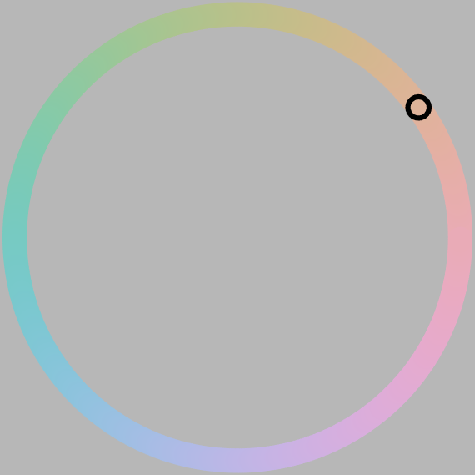
Choice

Slide 21
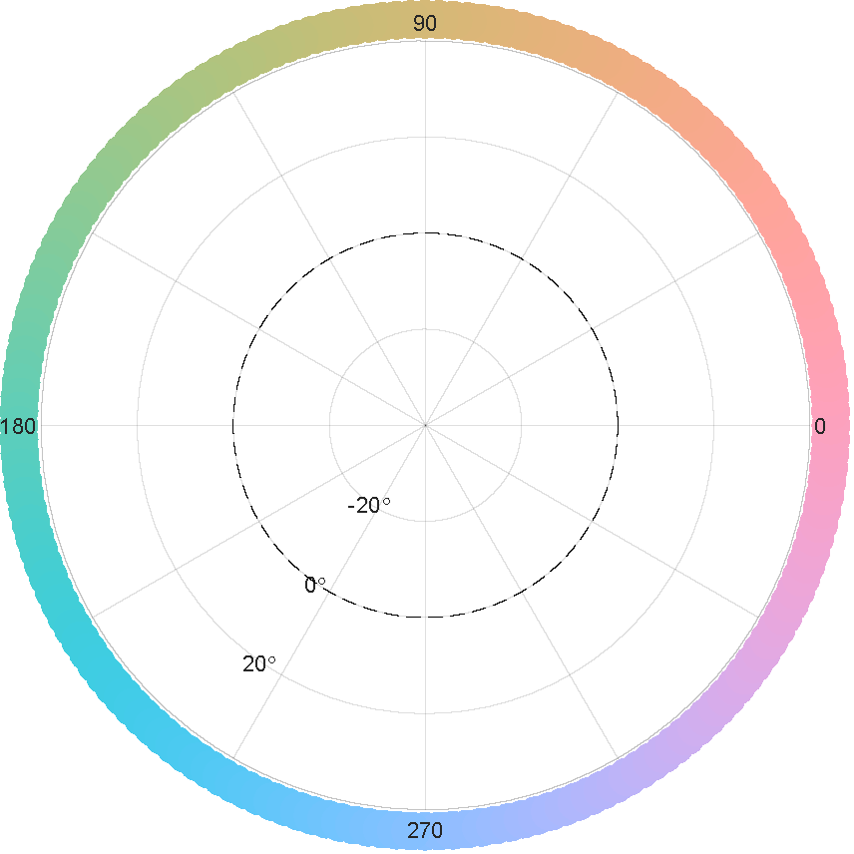
Replotted from Bae et al. (2015) JEP:G

Slide 22
*
Replotted from Bae et al. (2015) JEP:G

Slide 23
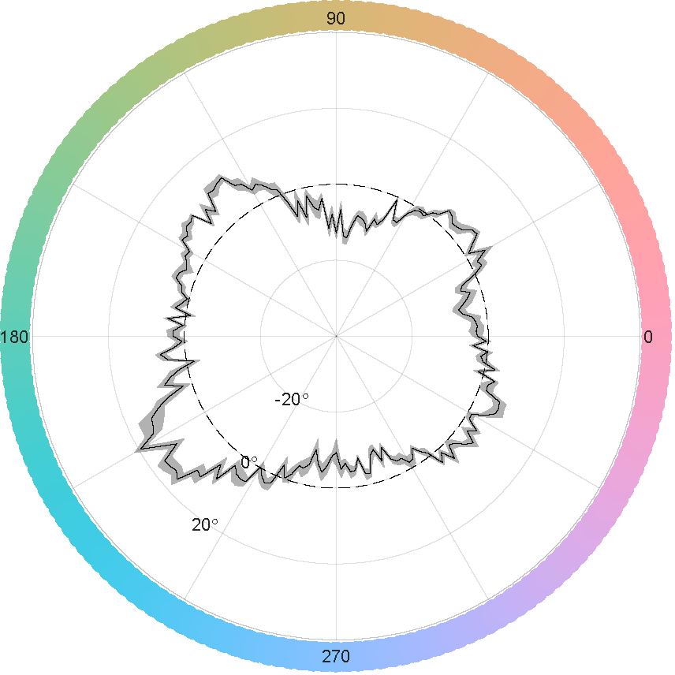
*
Replotted from Bae et al. (2015) JEP:G

Slide 24
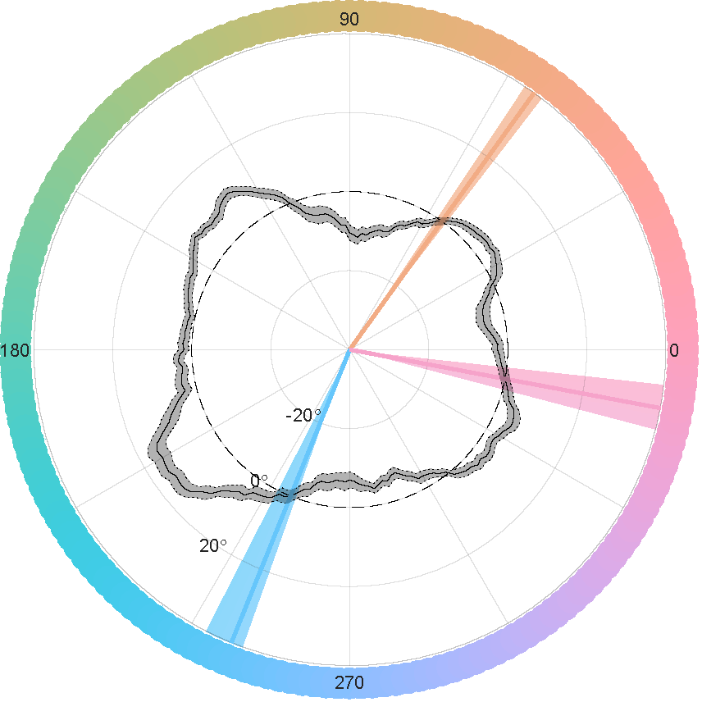
Replotted from Bae et al. (2015) JEP:G

Slide 25
Bae et al. (2015) JEP:G

Slide 26
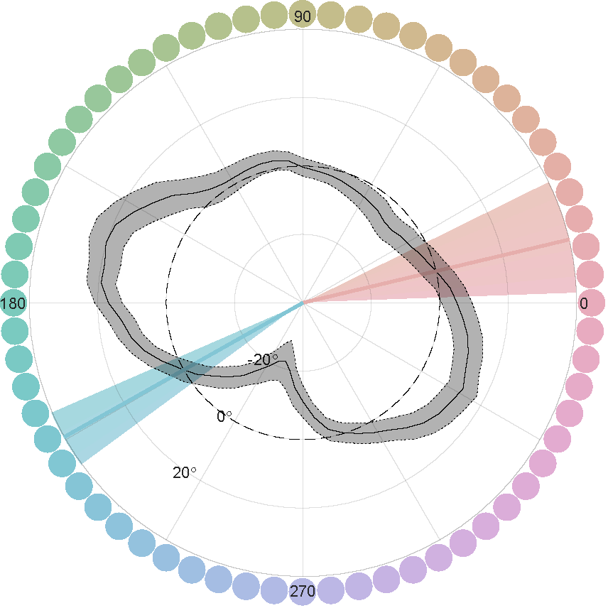
Human vs macaque
Replotted from Bae et al. (2015) JEP:G
Average data from 4 macaques

Slide 27
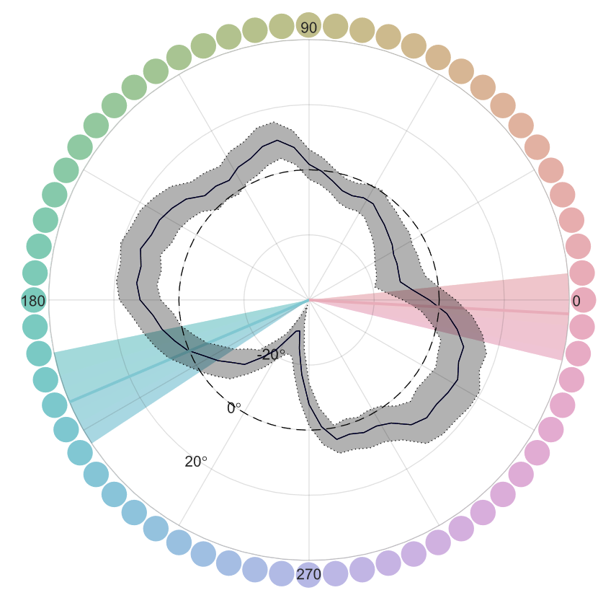
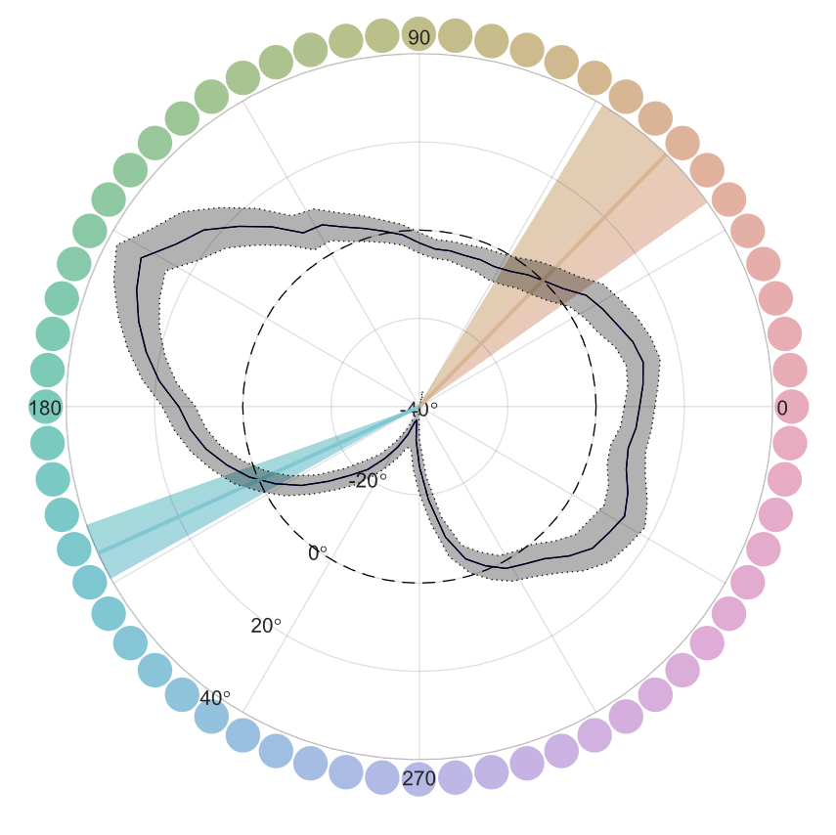
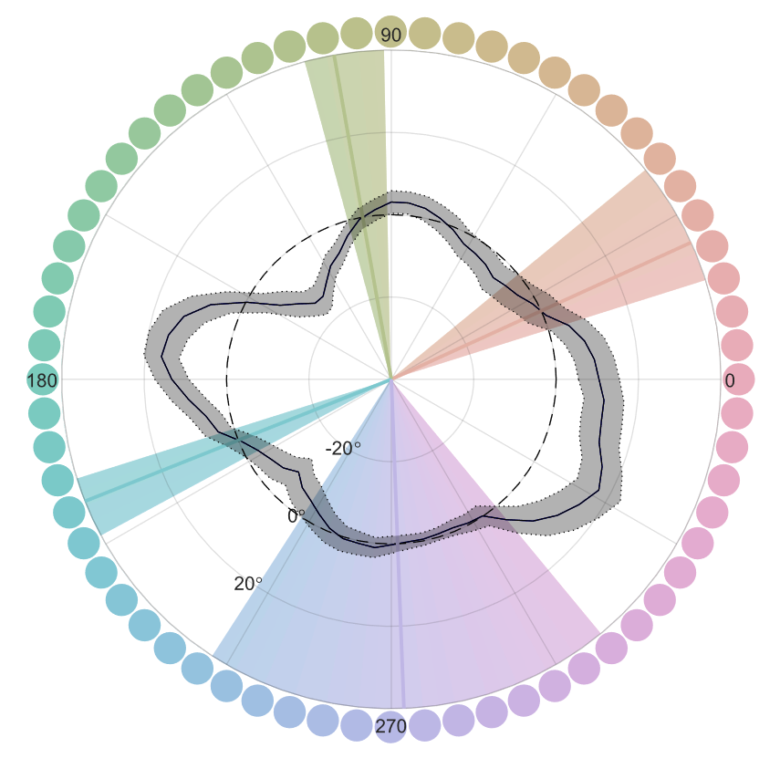
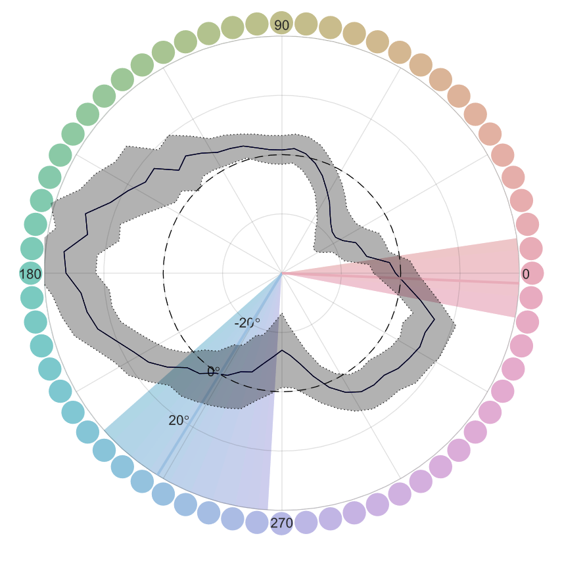
Individuals

Slide 28
Explain why non-uniformities in color space would be a problem

Slide 29
Introduce TCC modelling

Slide 30
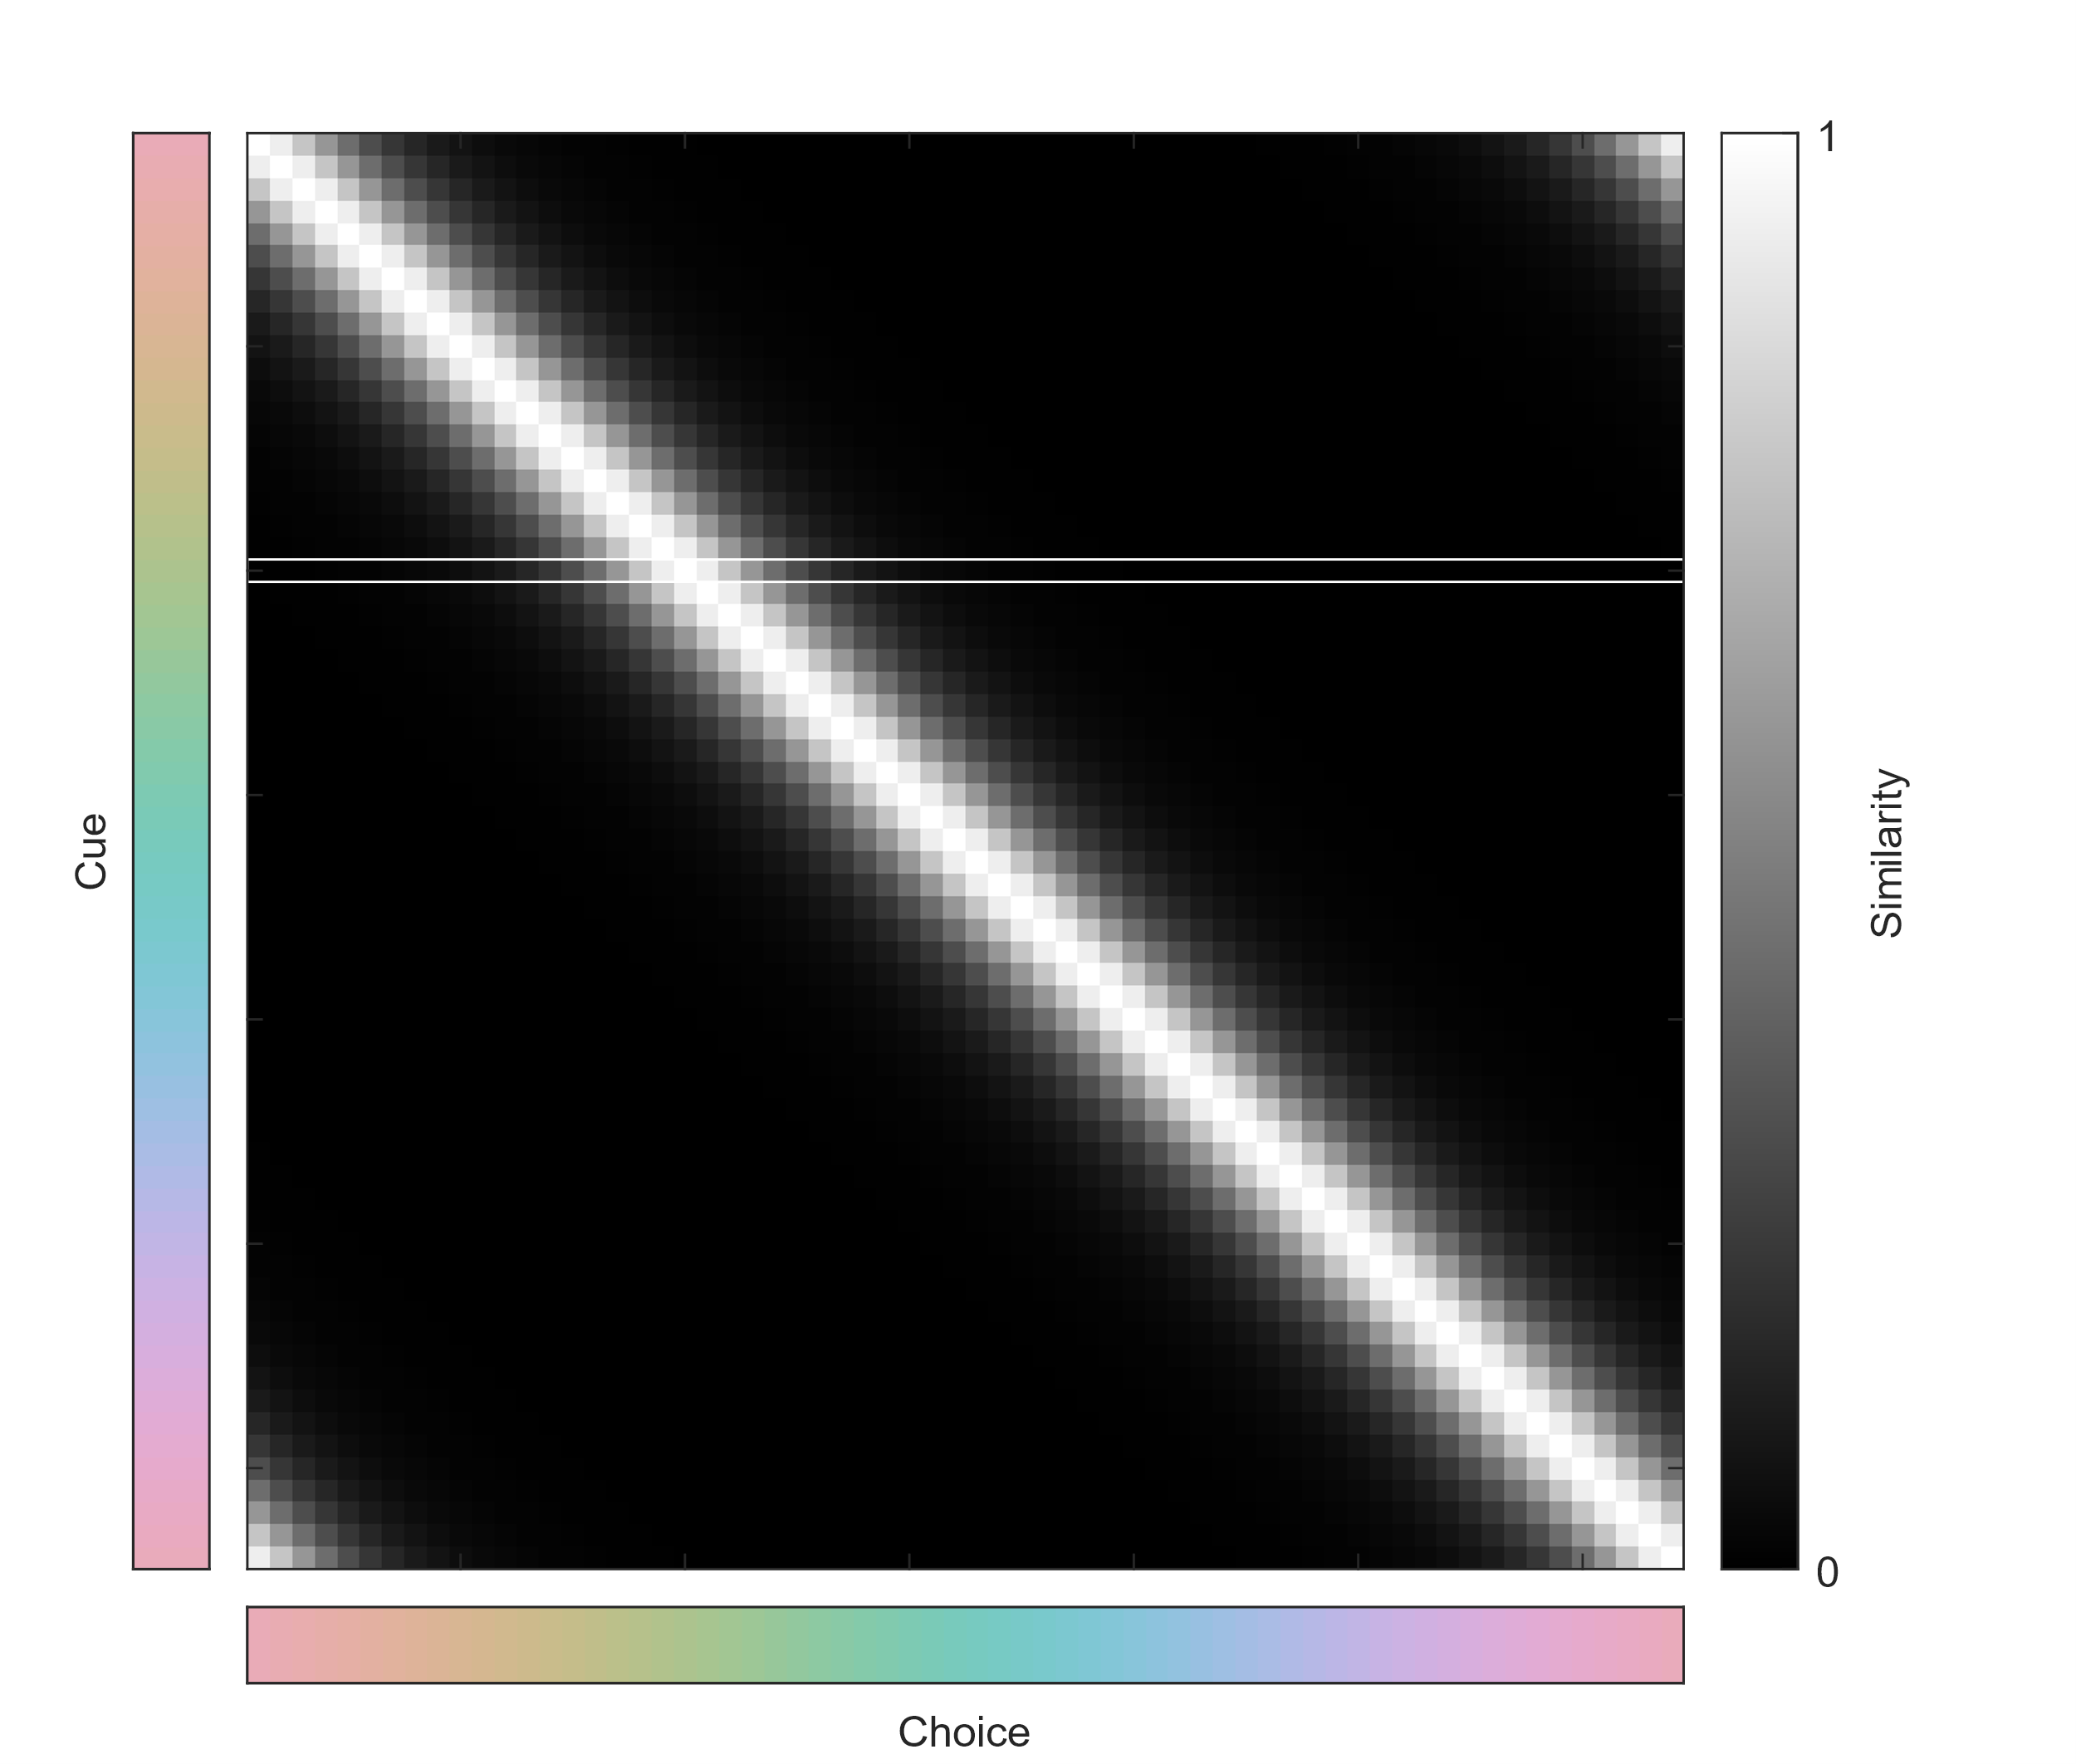
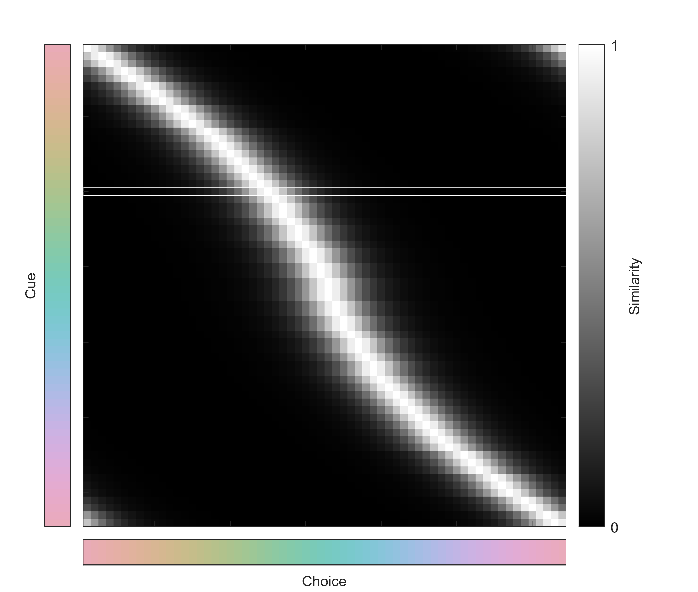
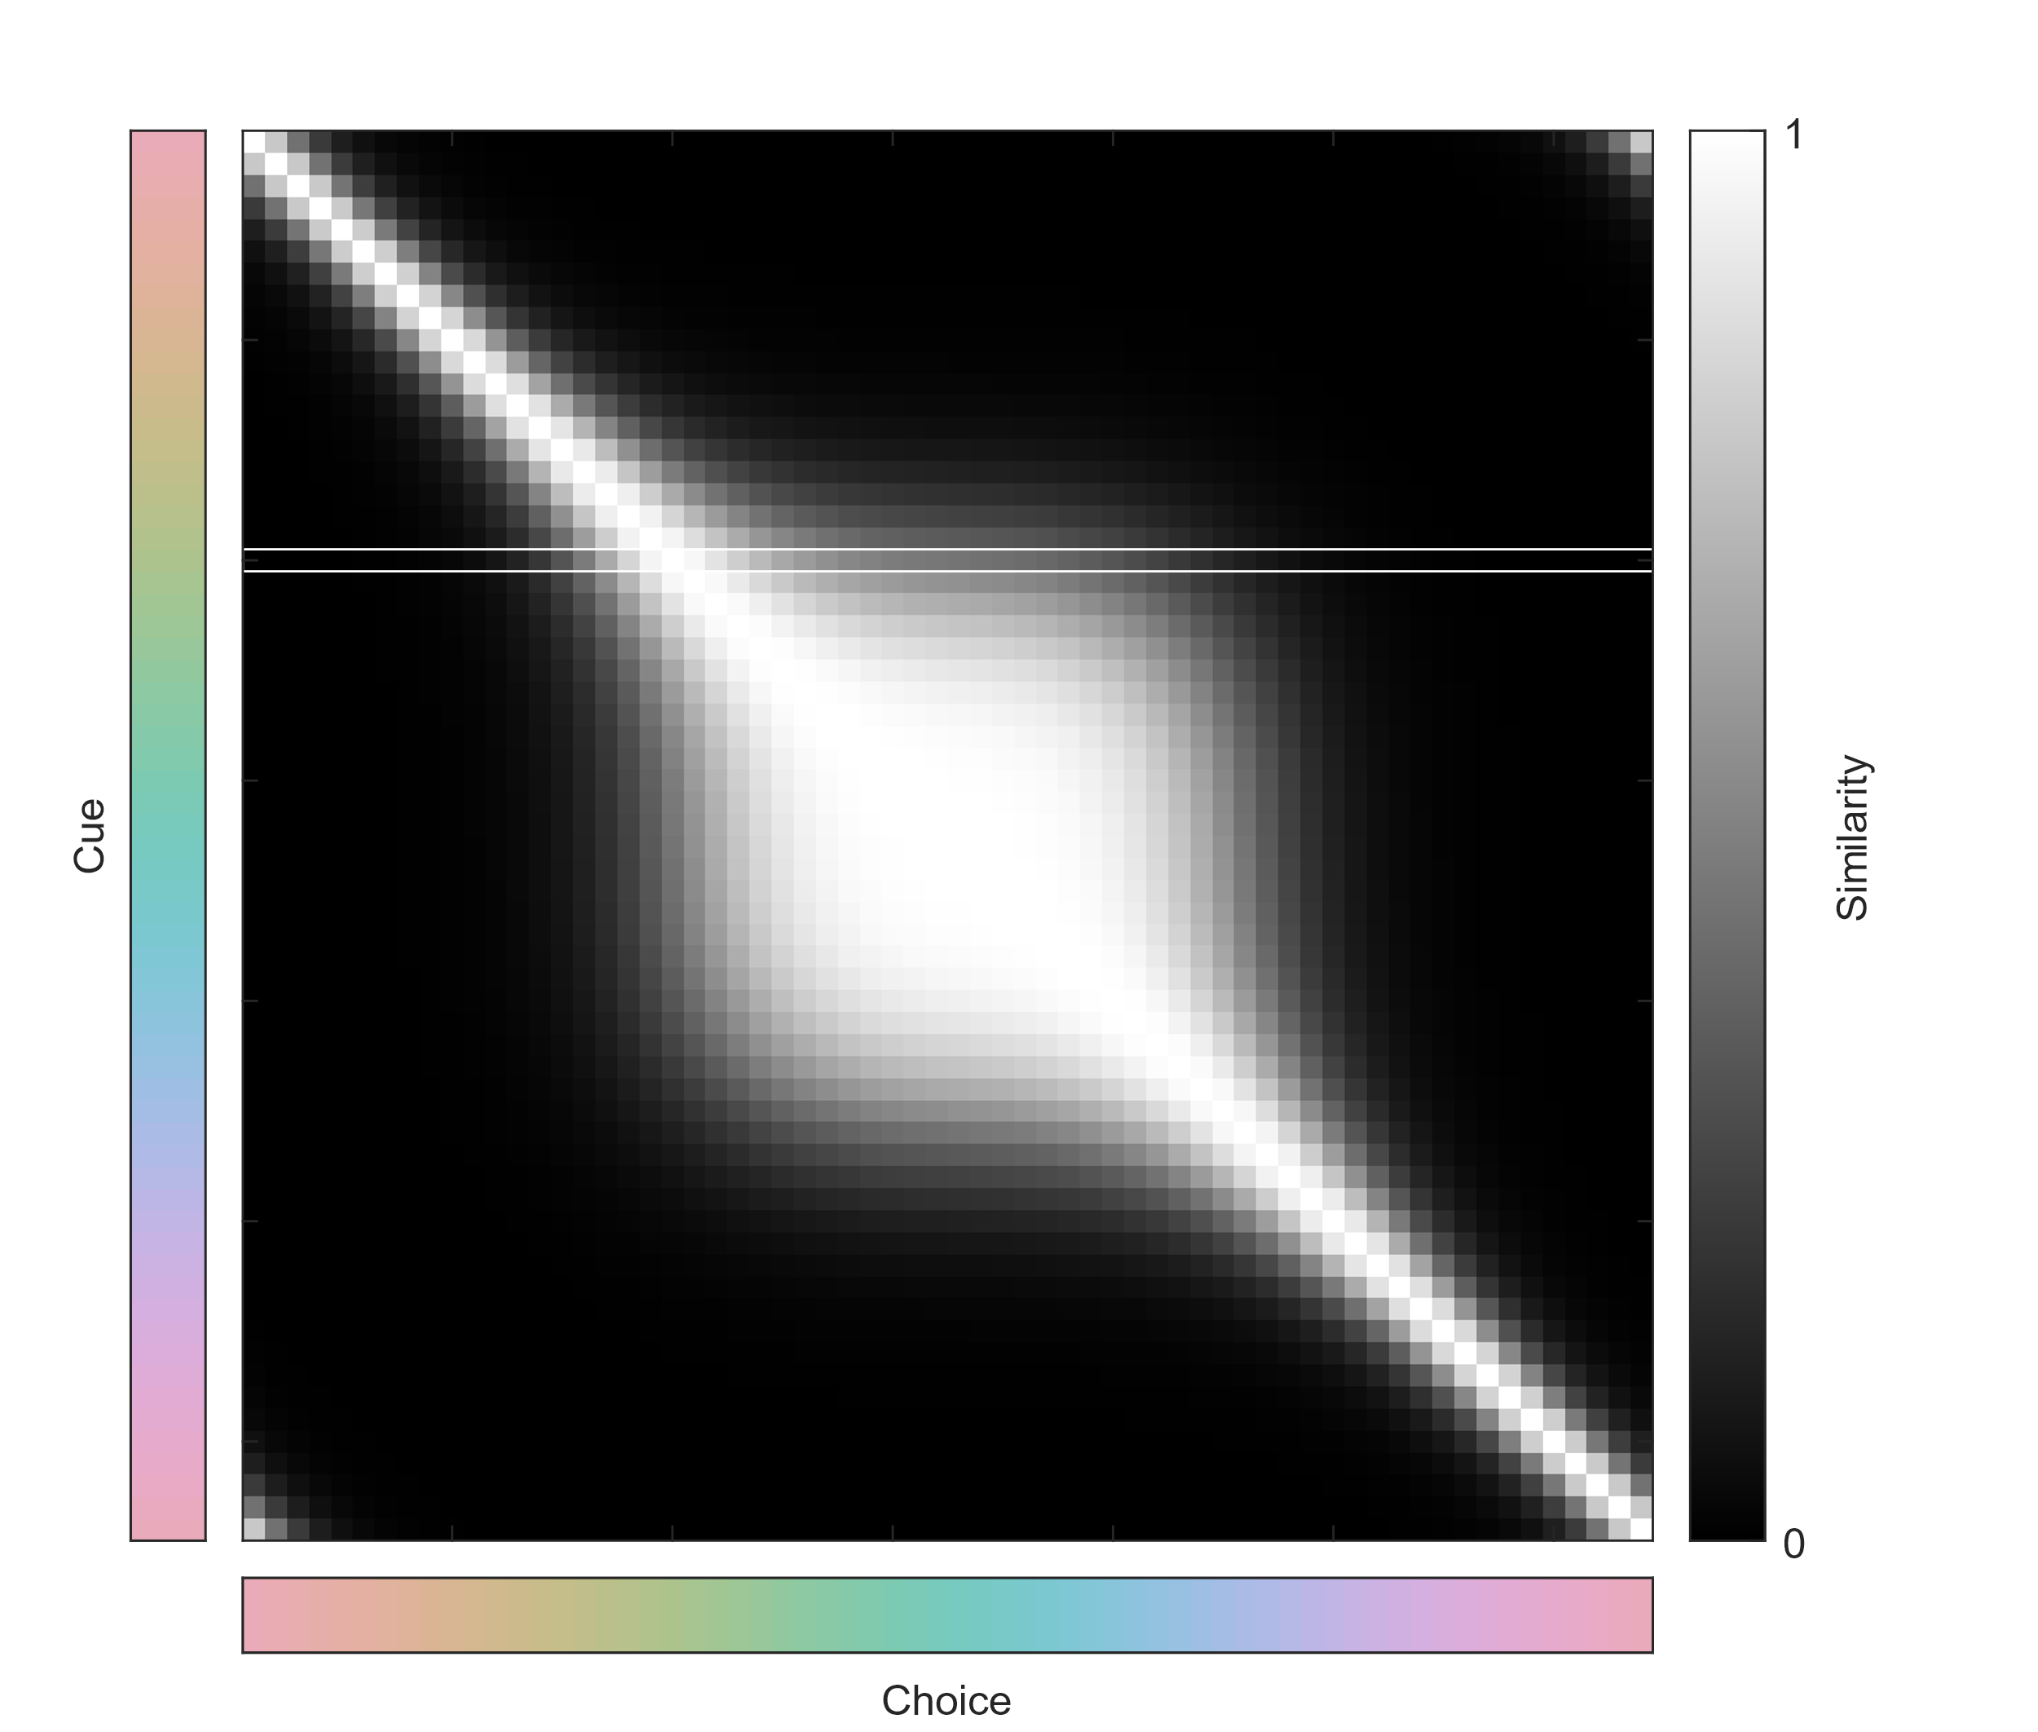
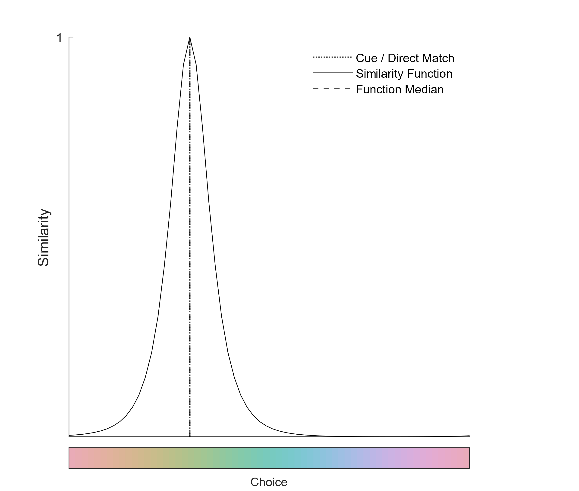
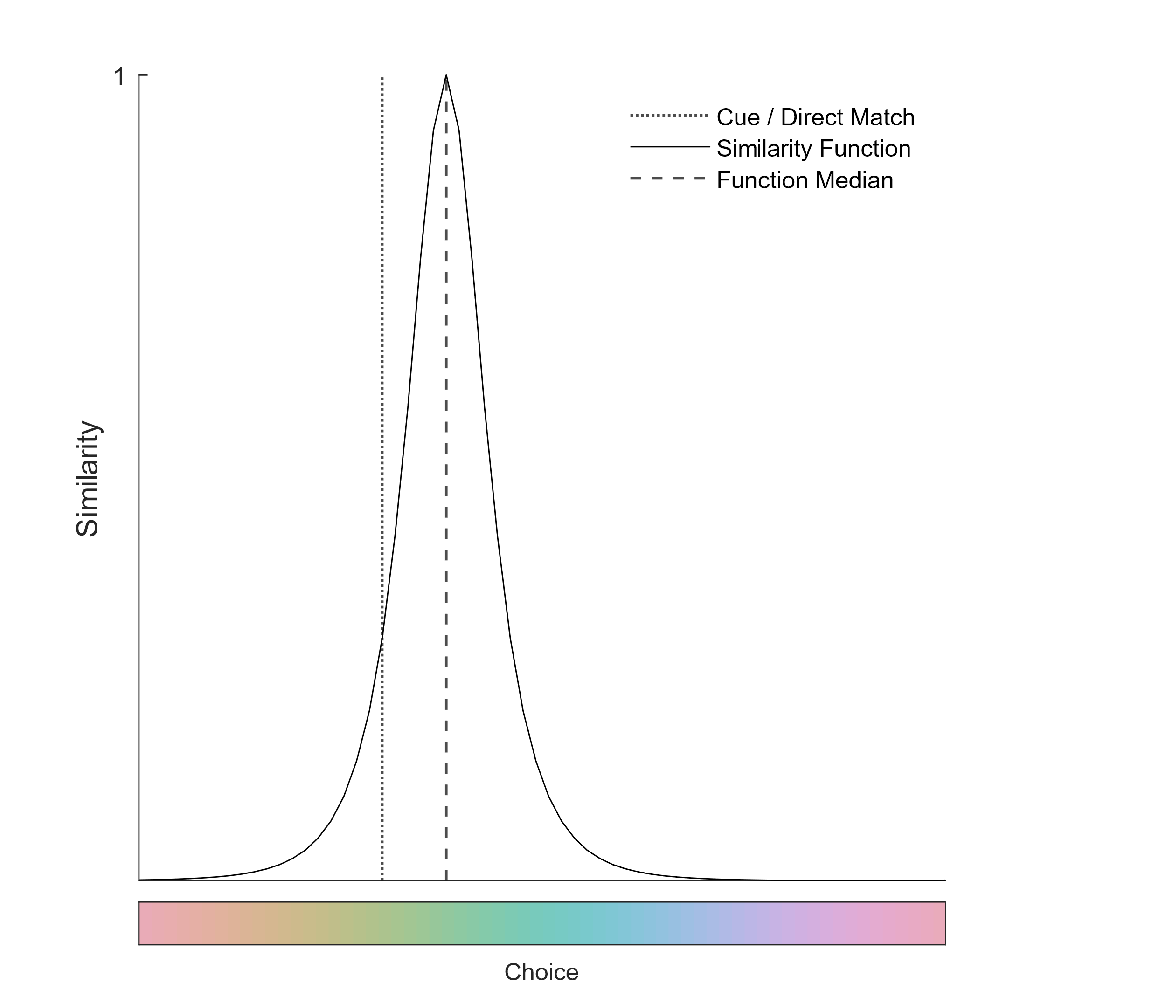
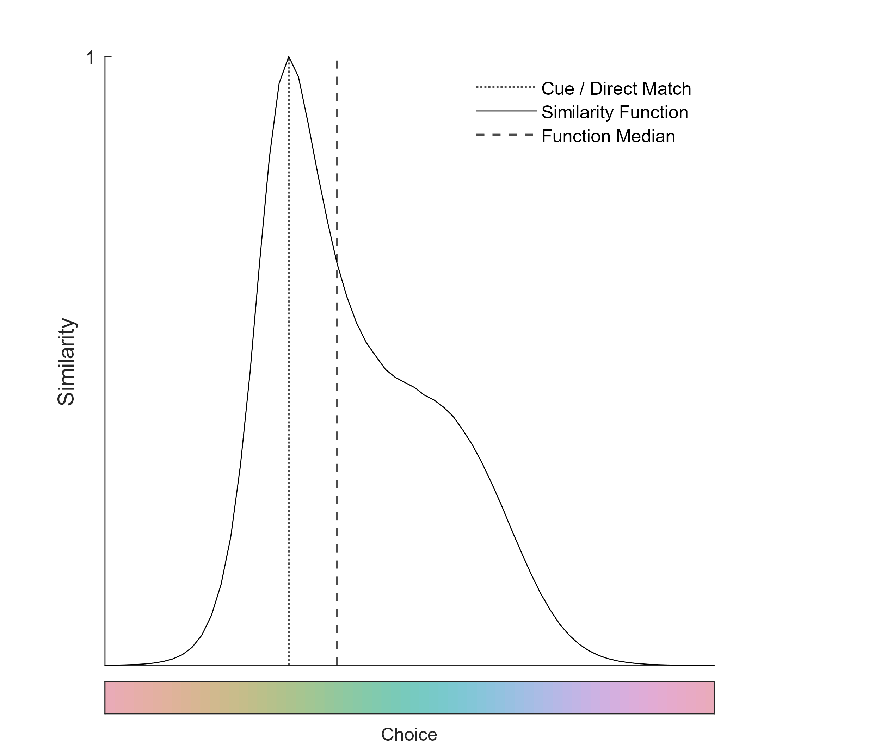

Slide 31
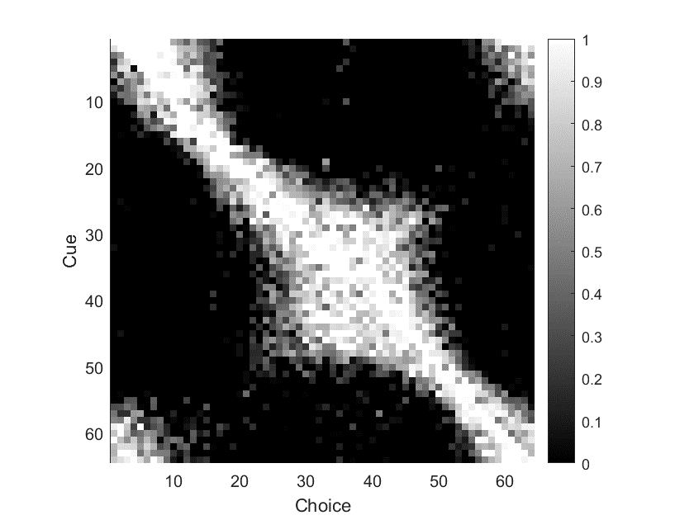
Notes:
On the right, we have a single similarity function, BUT the location of the represented point in colorspace is allowed to float - moving closer or further away from other points.

Slide 32
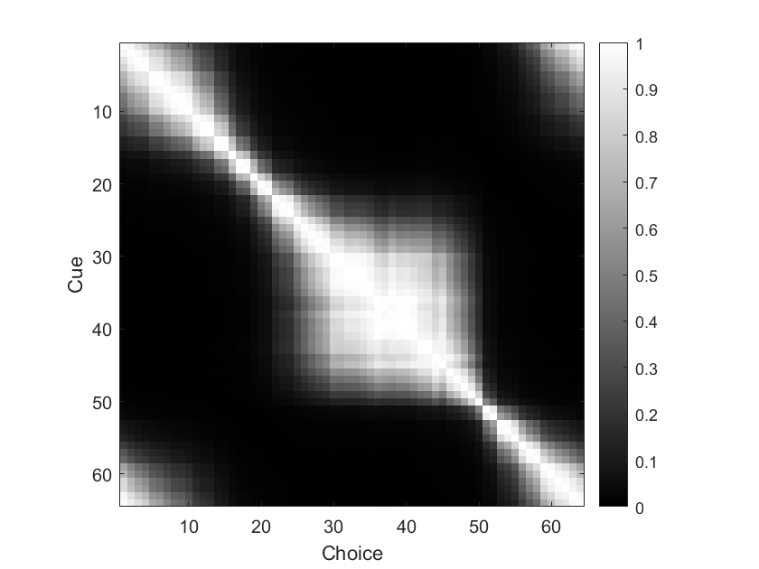
Notes:
On the right, we have a single similarity function, BUT the location of the represented point in colorspace is allowed to float - moving closer or further away from other points.

Slide 33
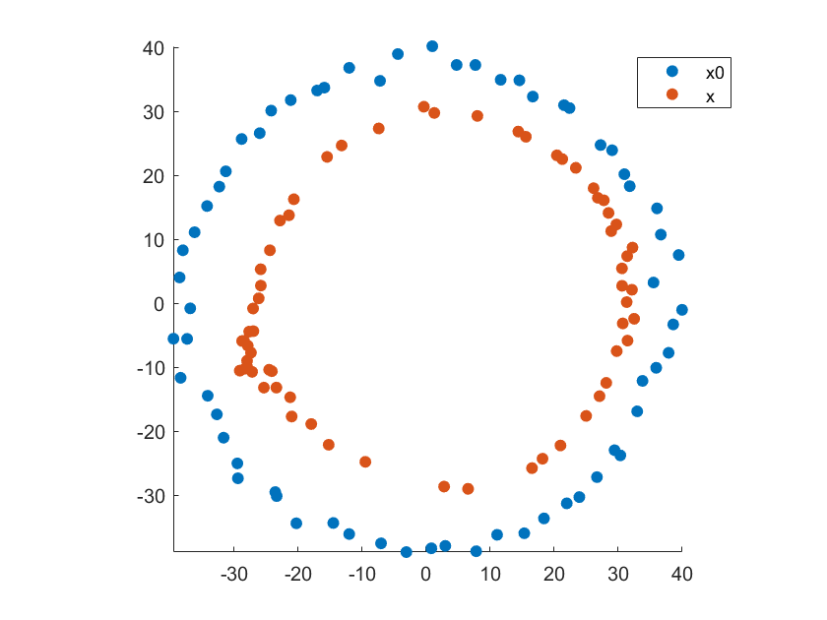
Notes:
On the left is a model with thousands of free parameters - the relationship between every cue and every choice is floating
On the right, we have a single similarity function, BUT the location of the represented point in colorspace is allowed to float - moving closer or further away from other points.

Slide 34
Notes:
On the left is a model with thousands of free parameters - the relationship between every cue and every choice is floating
On the right, we have a single similarity function, BUT the location of the represented point in colorspace is allowed to float - moving closer or further away from other points.

Slide 35
Conclusions
There are two color categories that are common to all 3 monkeys
These color categories correspond to the human distinction of warm and cool
The underlying template for the fundamental structure of color categories for trichromatic primates appears universal, potentially determined by the color statistics of relevant parts of scenes (objects)

Slide 36
Acknowledgements
Bevil Conway
Audrey Chang
Hannah Selwyn
Shriya Awasthi
Whitney Teagle
Riley Hoffman
NIH IRP funding
Animal care staff

Slide 37
Thank you!

